Slide 1
Backtracking
UNIT - VI

Slide 2
Difficult Problems
Partition
  Partition n positive integers s₁, s₂, s₃, …, s_{n} into two groups A and B such that the sum of the numbers in each group is the same.
  [9, 4, 6, 3, 5, 1,8]
  A = [9, 4, 5] and B = [6, 3, 1, 8]

Slide 3
Subset Sum Problem
Does any subset of n positive integers s₁, s₂, s₃, …, s_{n} have a sum exactly equal to c?
[9, 4, 6, 3, 5, 1,8] and c = 18
A = [9, 4, 5]

Slide 4

n-Queens Problem
A queen that is placed on an n x n chessboard, may attack any piece placed in the same column, row, or diagonal.
8x8 Chessboard

Slide 5
n-Queens Problem
Can n queens be placed on an n x n chessboard so that no queen may attack another queen?
4x4
Notes:
Problem may be solved in O(n) time by considering the cases: n is odd, n mod 6 = 2, else (n is even and n mod 6 != 2). However, solution eluded researchers for years. Although problem is no longer hard, it was hard for quite a while. See Explicit solutions to the N-queens problem for all N, Bo Bernhardsson, ACM SIGART Bulletin, 2(2), page 7. No placement is possible for n < 4. For n >= 4, the placement is always possible.

Slide 6
n-Queens Problem
8x8

Slide 7
Difficult Problems
Many require you to find either a subset or permutation that satisfies some constraints and (possibly also) optimizes some objective function.
May be solved by organizing the solution space into a tree and systematically searching this tree for the answer.

Slide 8
Solution Space
Solution Space is a set that includes at least one solution to the problem.
Subset problem.
  n = 2, {00, 01, 10, 11}
  n = 3, {000, 001, 010, 100, 011, 101, 110, 111}
Solution space for subset problem has 2^{n} members.
Nonsystematic search of the space for the answer takes O(p2^{n}) time, where p is the time needed to evaluate each member of the solution space.

Slide 9
Solution Space
Permutation problem.
  n = 2, {12, 21}
  n = 3, {123, 132, 213, 231, 312, 321}
Solution space for a permutation problem has n! members.
Nonsystematic search of the space for the answer takes O(pn!) time, where p is the time needed to evaluate a member of the solution space.

Slide 10
Backtracking and Branch and Bound
Backtracking and branch and bound perform a systematic search; often taking much less time than taken by a nonsystematic search.

Slide 11
Tree Organization Of Solution Space
Set up a tree structure such that the paths from root to leaves represent members of the solution space.
For a size n subset problem, this tree structure has 2^{n} leaves.
For a size n permutation problem, this tree structure has n! leaves.
The tree structure is too big to store in memory; it also takes too much time to create the tree structure.
Portions of the tree structure are created by the backtracking and branch and bound algorithms as needed.
Notes:
Tree organizations in which nonleaf nodes represent members of the solution space are also possible.

Slide 12
Subset Problem tree structure
Use a full binary tree that has 2^{n} leaves.
At level i the members of the solution space are partitioned by their x_{i} values.
Members with x_{i} = 1 are in the left subtree.
Members with x_{i} = 0 are in the right subtree.

Slide 13
Subset Tree For n = 4
( fixed – sized tuple )
x₁=1
x₁= 0
x₂=1
x₂= 0
x₂=1
x₂= 0
x₃=1
x₃= 0
x₄=1
x₄=0
0111
0001
1110
1011

Slide 14
Permutation Problem tree structure
Use a tree that has n! leaves.
At level i the members of the solution space are partitioned by their x_{i} values.
Members (if any) with x_{i} = 1 are in the first subtree.
Members (if any) with x_{i} = 2 are in the next subtree.
And so on.

Slide 15
Permutation Tree For n = 3
x₁=1
x₁= 3
x₁=2
x₂= 2
x₂= 3
x₂= 1
x₂= 3
x₂= 1
x₂= 2
x₃=3
x₃=2
x₃=3
x₃=1
x₃=2
x₃=1
123
132
213
231
312
321

Slide 16
Backtracking
Searches the solution space tree in a depth-first manner.
May be done recursively or use a stack to retain the path from the root to the current node in the tree.
The solution space tree exists only in your mind, not in the computer.

Slide 17
Backtracking Depth-First Search
x₁=1
x₁= 0
x₂=1
x₂= 0
x₂=1
x₂= 0

Slide 18
Backtracking Depth-First Search
x₁=1
x₁= 0
x₂=1
x₂= 0
x₂=1
x₂= 0

Slide 19
Backtracking Depth-First Search
x₁=1
x₁= 0
x₂=1
x₂= 0
x₂=1
x₂= 0

Slide 20
Backtracking Depth-First Search
x₁=1
x₁= 0
x₂=1
x₂= 0
x₂=1
x₂= 0

Slide 21
Backtracking Depth-First Search
x₁=1
x₁= 0
x₂=1
x₂= 0
x₂=1
x₂= 0

Slide 22
n – queens problem:-
The problem is to place n queens on an n×n chessboard so that no two “attack” that is no two queens on the same row, column, or diagonal.

Slide 23
Defining the problem:-
Assume rows and columns of chessboard are numbered 1 through n.
Queens also be numbered 1 through n.
Since each queen must be on a different row ,hence assume queen i is to be placed on row i.
Therefore all solutions to the n-queens problem can be represented as n-tuples ( x₁,x₂,…..x_{n}), where x_{i} is the column on which queen i is placed.

Slide 24
Tree structure for the case n=4.

Slide 25
1
X₁=1
X₁=4
X₁=2
X₁=3
2
34
50
18
x₂=
1
2
4
1
2
3
2
3
4
1
3
4
3
8
13
19
24
29
35
40
45
51
56
61
x₃=
3
4
2
4
2
3
3
4
1
4
1
3
2
4
1
4
1
2
2
3
1
3
1
2
4
6
9
11
14
16
20
22
25
27
30
32
36
38
41
43
46
48
52
54
57
59
62
64
x₄=
4
3
4
2
3
2
4
3
4
1
3
1
4
2
4
1
2
1
3
2
3
1
2
1
5
7
10
12
15
17
21
23
26
28
31
33
37
39
42
44
47
9
53
55
58
60
63
65
Tree organization of the 4-queens solution space. Nodes are numbered as in depth first search.

Slide 26
1
x₁=1
x₁=2
2
18
x₂=2
x₂=3
x₂=4
x₂=4
3
8
13
29
19
24
B
B
B
x₃=1
9
11
14
16
30
B
B
B
x₄=3
15
31
B
Portion of the tree that is generated during backtracking( n=4 ).

Slide 27
n - queens problem algorithm
Every element on the same diagonal that runs from the upper left to the lower right has the same row – column value.
Similarly, every element on the on the same diagonal that goes from the upper right to the lower left has the same row + column value.

Slide 28
If two queens are placed at positions ( i, j ) and ( k, l ) , then they are on the same diagonal only if
i – j = k – l or i + j = k + l
First equation implies
j – l = i – k
Second equation implies
j – l = k – i
Therefore, two queens lie on the same diagonal if and only if j – l = i – k

Slide 29
Algorithm place( k, l )
// It returns true if a queen can be placed in column i
// It tests both whether i is distinct from all previous values
// x [ 1 ], ….x [ k-1 ] and there is other queen on the same
//diagonal.
// Abs(r) returns the absolute value of r.
{
for j = 1 to k-1 do // for all previous queens
{ // Two in the same column or in the same diagonal
if ( ( x [ j ] = l ) or ( Abs( x[ j ] - l ) = Abs( j - k ) ) ) then
return false;
}
return true ;
}

Slide 30
Algorithm NQueen(k,n)
//Using backtracking, this procedure prints all
//possible placements of n queens on an n×n
//chessboard so that they are nonattacking.
{
for l =1 to n do // check place of column for queen k
{
if place( k, l ) then
{
x[ k ] = l;
if( k = n )then write( x[1:n] );
else NQueens( k+1, n);
}
}
}

Slide 31
Sum of subsets
Given n distinct positive numbers w_{i}, and m, find all subsets whose sums are m.
We can formulate this problem using either
  Fixed- or variable – sized tuples.

Slide 32
Variable- sized tuple
Ex:- n=4, ( w1, w2, w3, w4 )= ( 11,13, 24, 7 ), m=31.
  Solutions are ( 11, 13, 7 ) and ( 24, 7 )
Rather than representing the solution by w_{i} ’s, we can represent by giving the indices of these w_{i}
Now the solutions are ( 1, 2, 4 ) and ( 3, 4 ).
Different solutions may have different-sized tuples.
We use the following condition to avoid generating multiple instances of the same subset ( e.g., ( 1,2,4) and (1,4,2) )
  x_{i} < x_{i+1}

Slide 33
Subset Tree for n=4 (variable- sized tuple )
1
x₁=1
x₁=4
x₁=2
x₁=3
3
4
5
2
x₂=4
x₂=3
x₂=4
x₂=4
x₁=2
x₂=3
8
9
10
11
6
7
x₃=3
x₃=4
x₃=4
x₃=4
12
13
14
9
x₄=3
16
Nodes are numbered as in Breadth first search.

Slide 34
Fixed- sized tuple
In this method, each solution subset is represented by an n-tuple (x₁,x₂,…..x _{n}).
x _{i}=0 if w_{i} is not chosen and x_{i}=1 if w_{i} is chosen
Subset Tree for n=4 (Fixed- sized tuple )
We have already discussed.
Copy that tree.

Slide 35
Subset Tree For n = 4
( fixed – sized tuple )
x₁=1
x₁= 0
x₂=1
x₂= 0
x₂=1
x₂= 0
x₃=1
x₃= 0
x₄=1
x₄=0
0111
0001
1110
1011

Slide 36
Algorithm of sum of subsets
Backtracking solution using fixed- sized tuple.
A simple choice for bounding function is B_{k}(x₁,x₂,…..,x_{k})= true iff
∑ w_{i}x_{i} + ∑ w_{i} ≥ m
Clearly x₁,x₂,……x_{k} cannot lead to an answer node if this condition is not satisfied.
k
n
i=1
i=k+1

Slide 37
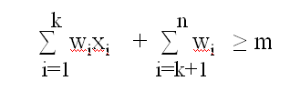
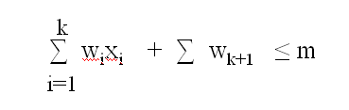
The bounding function strength further can be increased if we assume the w_{i}’s in increasing order.
In this case x₁,x₂,……x_{k} cannot lead to an answer node if
∑ w_{i}x_{i} + ∑ w_{k+1} > m
Therefore, the bounding functions we use are
  B_{k}(x₁,x₂,…..,x_{k})= true iff
k
i=1
and

Slide 38
The initial call is SumOfSub( 0, 1, ∑ w_{i} )
Algorithm SumOfSub( s, k, r )
// Find all subsets of w[ 1:n ] that sum to m
// It is assumed that w[1] ≤ m and ∑ w_{i} ≥ m
{
x[ k ]=1; // left child
if( s + w[k] = m ) then write( x[ 1: k ] ) ; // Subset found
else if ( s + s [ k ] + s[ k+1 ] ≤ m )
then SumOfSub( s+ w[k], k+1, r- w[k] )
// Generate right child and evaluate B_{k}
if ( ( s + r – w[ k ] ≥ m ) and ( s + w[ k+1 ] ≤ m ) ) then
{
x[ k ] = 0;
} SumOfSub( s, k+1, r- w[k] ) ;
}
n
i=1
n
i=1

Slide 39
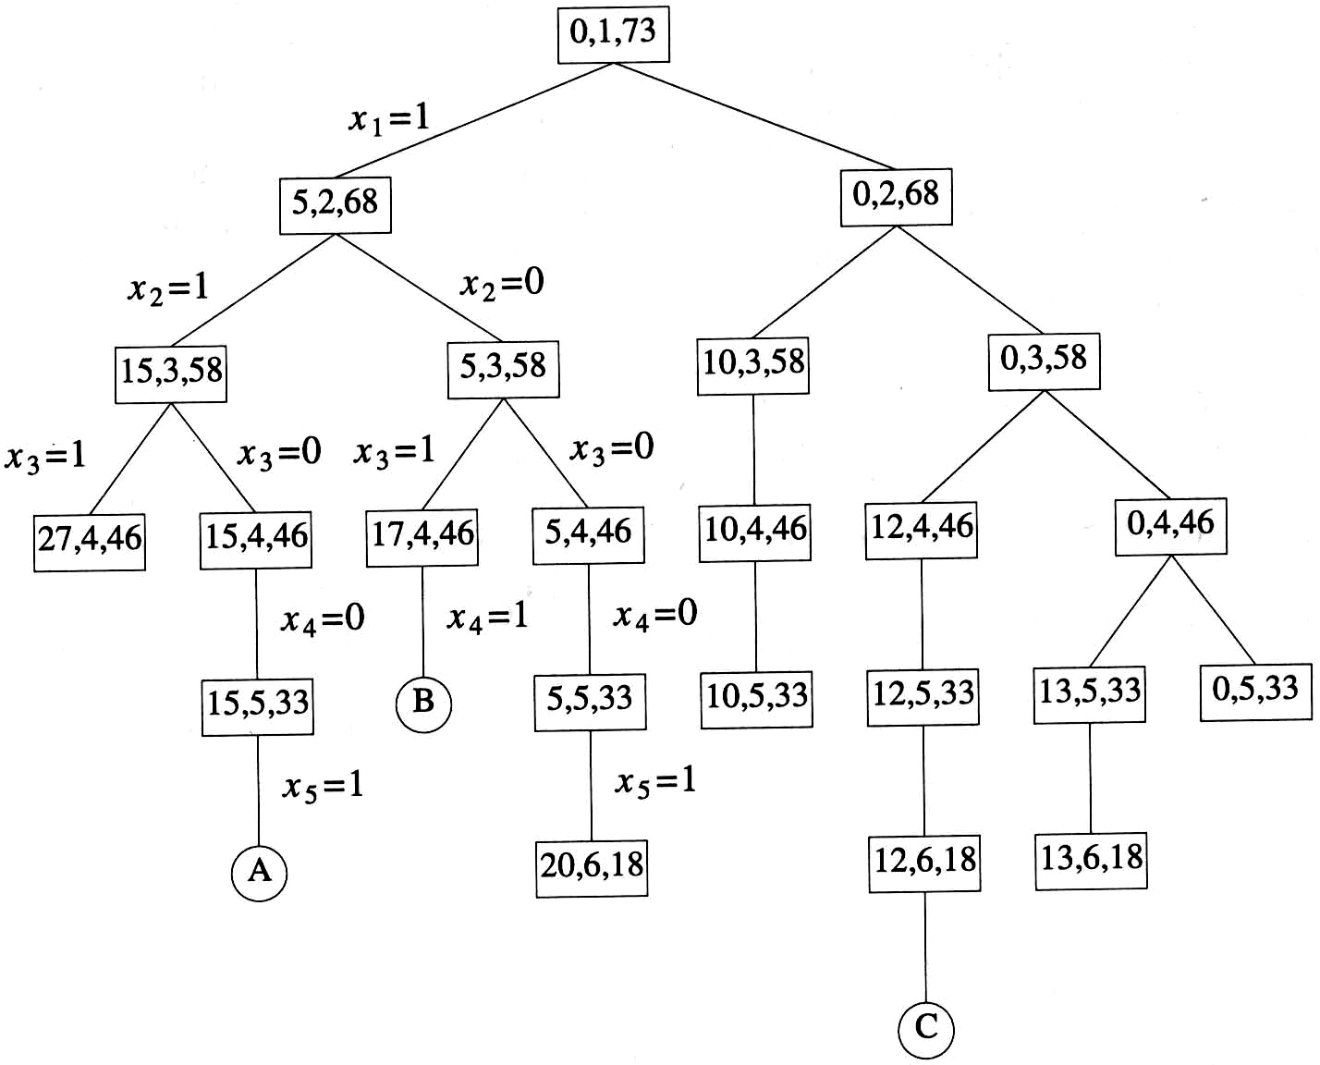
Ex:- n=6, m=30, w [ 1:6 ]= { 5,10,12,13,15,18 }
Portion of state space tree generated by SumOfSub. circular nodes indicate subsets with sums equal to m.
Example 7.6 (Figure 7.10)
  n=6, w[1:6]={5,10,12,13,15,18}, m=30

Slide 40
General method of Backtracking
Let T ( x[1], x[2],…..x[ k-1 ] be the partial solution
Algorithm Backtrack( k )
{
for( each x[k] € T ( x[1], x[2],…..x[ k-1 ] ) do
{
if( B_{k} (x[1], x[2],…..x[ k-1 ], x[k] is true ) then
{
if ( x[1], x[2],…..x[ k-1 ], x[k] ) is an answer )
then write( x [ 1; k ] );
if ( k < n ) then Backtrack ( k+1 );
}
}
}

Slide 41
Graph Coloring Problem
Assign colors to the vertices of a graph so that no adjacent vertices share the same color.
  Vertices i, j are adjacent if there is an edge from vertex i to vertex j.

Slide 42
Example
No.of Colors used: 2
Number of Possible ways : 2

Slide 43
No.of Colors used: 3
.
.
.
Some possible ways

Slide 44
m-colorings problem:-
  Find all ways to color a graph with at most m colors.
  Problem formulation:-
  Represent the grapth with adjacency matrix G[1:n,1:n].
  The colors are represented by integer numbers 1,2,….m.
  Solution is represented by n- tuple (x₁,….x_{n}), where x_{i} is the color of node i.

Slide 45
Solution space tree for mColorigng when n=3 and m=3
x₁=1
2
3
3
1
3
1
3
x₂ =1
2
2
2
X3 =1
2
3

Slide 46
A 4-node graph and all possible 3-colorings
1
2
4
3
x₁=
1
2
3
X₂=
2
3
1
3
1
2
X₃=
1
3
1
2
2
3
1
2
2
3
1
3
X₄=
2
3
2
2
3
3
1
3
1
3
1
3
1
1
2
2
1
2

Slide 47
Algorithm :- finding all m- colorings of a graph.
Function mColoring is begun by first assiging the graph to its adjacency matrix, setting the array x[ ] to zero, and then invoking the statement mColoring( 1 );
Algorithm mColoring( k )
// k is the index of the next vertex to color.
{
repeat
{ // Generate all legal assignments for x[k]
NextValue( k ); // Assign to x[k] a legal color
if ( x[k]=0 ) then return; // No new color possible
if ( k=n ) then // At most m colors have been used to color the n vertices
write( x[1:n] );
else mColoring( k+1);
} until ( false );
}

Slide 48
Algorithm NextValue( k )
// x[1],…..x[ k-1 ] have been assigned integer values in the range [ 1 ,m ].
// A value for x[ k ] is determined in the range [ 0,m ]
{
repeat
{
x[k] = ( x[k] +1) mod ( m+1 ); // Next highest color.
if ( x[k]=0 ) then return; // All colors have been used.
for j = 1 to n do
{
if (( G[ k,j ] ≠ 0 ) and ( x[k] = x[j] )) then
break;
}
if( j = n+1 ) then return; // Color found
} until ( false );
}

Slide 49
Hamiltonian cycles:-
A Hamiltonian cycle is a round-trip path along n edges of connected undirected graph G that visits every vertex once and returns to its starting position.
The above graph contains the Hamiltonian cycle
1,2,8,7,6,5,4,3,1
1
2
3
4
8
7
6
5

Slide 50
The above graph does not contain Hamiltonian cycles.
1
2
3
5
4

Slide 51
  Find all possible Hamiltonian cycles
  Problem formulation:-
  Represent the grapth with adjacency matrix G[1:n,1:n].
  Solution is represented by n- tuple (x₁,….x_{n}), where x_{i} represents the i^{th} visited vertex of the cycle.
  Start by setting x[ 2: n ] to zero and x[ 1 ]=1, and then executing Hamiltonian( 2 );

Slide 52
Algorithm Hamiltonian( k )
{
repeat
{ // Generate values for x[k]
NextValue( k ); // Assign a legal next value to x[ k ]
if ( x[k]=0 ) then return; // No new value possible
if ( k=n ) then write( x[1:n] );
else Hamiltonian( k+1);
} until ( false );
}

Slide 53
Algorithm NextValue( k )
{
repeat
{
x[k] = ( x[k] +1) mod ( m+1 ); // Next vertex.
if ( x[k]=0 ) then return;
if( G[ x[ k-1], x[ k ] ] ≠ 0 )
{
for j:= 1 to k-1 do if ( x[ j ] = x [k ] ) then break;
if( j = k ) then // if true, then the vertex is distinct
if( ( k < n ) or ( ( k=n ) and G [ x[n], x[1]] ≠ 0 )
then return;
}
} until ( false );
}

Slide 54
State Space :-
All paths from the root to other nodes define the state space of the problem.
Solution Space :-
All paths from the root to solution states define the solution space of the problem.

Slide 55
Ex :-
1
X₁=1
X₁=4
X₁=2
X₁=3
2
34
50
18
x₂=
1
2
4
1
2
3
2
3
4
1
3
4
3
8
13
19
24
29
35
40
45
51
56
61
x₃=
3
4
2
4
2
3
3
4
1
4
1
3
2
4
1
4
1
2
2
3
1
3
1
2
4
6
9
11
14
16
20
22
25
27
30
32
36
38
41
43
46
48
52
54
57
59
62
64
x₄=
4
3
4
2
3
2
4
3
4
1
3
1
4
2
4
1
2
1
3
2
3
1
2
1
5
7
10
12
15
17
21
23
26
28
31
33
37
39
42
44
47
9
53
55
58
60
63
65
Tree organization of the 4-queens solution space. Nodes are numbered as in depth first search.

Slide 56
Problem state :-
Each node in the tree is a problem state.
Ex:-
and so on
1
2
18

Slide 57
Solution States :-
These are those problem states S for which the path from the root to S define a tuple in the solution space.
Ex:-
and so on
5
7
10
12
15
17
21

Slide 58
General Backtracking Algorithms :-
Assume all answer nodes are to be found.
Let (x1,x2,…..,xi) be a path from the root to a node xi in a state space tree .
Let T(x1,x2,…..xi) be the set of all possible paths for x_{i+1} such that (x1,x2,…….., x_{i+1}) is also a path to a problem state.
Assume bounding functionBi+1 ( implicit conditions) such that if Bi+1(x1,x2,……,xi+1) is false for a path (x1,x2,…xi+1) , then the path cannot be expanded to reach an answer node.

Slide 59
General Recursive backtracking Algorithm:-
Algorithm Backtrack( k )
// The first k-1 values have been assigned.
// x[ ] and n are global.
{
for ( each x[k] € T(x[1],……x[k-1] )
{
if( Bk( x[1],x[2],…..x[k] ≠ 0) then
{
if(x[1],x[2],…..x[k] is a path to answer node )
then write( x[1:k] );
if ( k < n) then Backtrack( k+1 );
}
}
}

Slide 60
O(2^{n}) Subet Sum & Bounding Functions
{10, 5, 2, 1}, c = 14
x₁=1
x₁= 0
x₂=1
x₂= 0
x₂=1
x₂= 0
Each forward and backward move takes O(1) time.
Notes:
When you move forward on an x =1 branch, add to a variable that keeps track of the sum of the subset represented by the node. When you move back on an x = 1 branch, subtract. Moving in either direction along an x = 0 branch requires no add/subtract. When you reach a node with the desired sum, terminate. When you reach a node whose sum exceeds the desired sum, backtrack; do not move into this nodes subtrees. When you make a right child move see if the desired sum is attainable by adding in all remaining integers; for this keep another variable that gives you the sum of the remaining integers.

Slide 61
Bounding Functions
When a node that represents a subset whose sum equals the desired sum c, terminate.
When a node that represents a subset whose sum exceeds the desired sum c, backtrack. I.e., do not enter its subtrees, go back to parent node.
Keep a variable r that gives you the sum of the numbers not yet considered. When you move to a right child, check if current subset sum + r >= c. If not, backtrack.

Slide 62
Backtracking
Space required is O(tree height).
With effective bounding functions, large instances can often be solved.
For some problems (e.g., 0/1 knapsack), the answer (or a very good solution) may be found quickly but a lot of additional time is needed to complete the search of the tree.
Run backtracking for as much time as is feasible and use best solution found up to that time.

Slide 63
Branch And Bound
Search the tree using a breadth-first search (FIFO branch and bound).
Search the tree as in a bfs, but replace the FIFO queue with a stack (LIFO branch and bound).
Replace the FIFO queue with a priority queue (least-cost (or max priority) branch and bound). The priority of a node p in the queue is based on an estimate of the likelihood that the answer node is in the subtree whose root is p.

Slide 64
Branch And Bound
Space required is O(number of leaves).
For some problems, solutions are at different levels of the tree (e.g., 16 puzzle).
4
14
1
1
2
3
4
13
2
3
12
5
6
7
8
6
11
5
10
9
10
11
12
9
8
7
15
13
14
15

Slide 65
Branch And Bound
  FIFO branch and bound finds solution closest to root.
  Backtracking may never find a solution because tree depth is infinite (unless repeating configurations are eliminated).
Least-cost branch and bound directs the search to parts of the space most likely to contain the answer. So it could perform better than backtracking.

